Slide 1
Year 9 Options Evening

Slide 2
GCSE Option Blocks
Block A | Block B | Block C | Block D
Geography | Citizenship | Art | Drama
History | Creative iMedia | Engineering | Engineering
 | French | Enterprise & Marketing | Enterprise & Marketing
 | Geography | Health & Social Care | French
 | Health & Social Care | Hospitality & Catering | Hospitality & Catering
 | Sport Studies | Music | Sport Studies
 |  | Triple Science

Slide 3
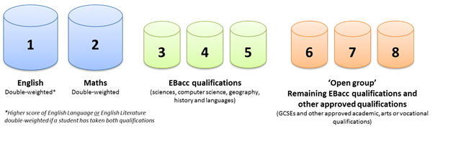
Progress 8

Slide 4
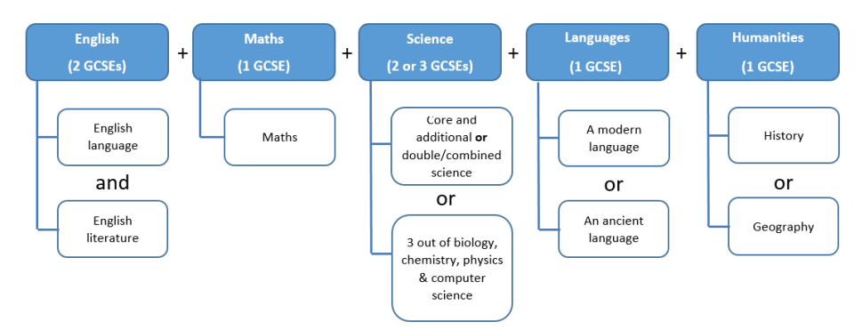
English Baccalaureate

Slide 5
Science
100% Exam at the end of Year 11
Triple Science | Trilogy (Combined Science)
3 GCSEs at the end of the course (Biology, Chemistry and Physics) Wider range of topics More teaching hours as more content Each paper is 1 hour 45 minutes Leads into KS5 Sciences | 2 GCSEs at the end of the course (Science) Narrower range of topics Less teaching hours as less content Each paper is 1 hour 15 minutes Leads into KS5 Sciences

Slide 6
Pathways – Example 1
Block A | Block B | Block C | Block D
Geography | Citizenship | Art | Drama
History | Creative iMedia | Engineering | Engineering
 | French | Enterprise & Marketing | Enterprise & Marketing
 | Geography | Health & Social Care | French
 | Health & Social Care | Hospitality & Catering | Hospitality & Catering
 | Sport Studies | Music | Sport Studies
 |  | Triple Science

Slide 7
Pathways – Example 2
Block A | Block B | Block C | Block D
Geography | Citizenship | Art | Drama
History | Creative iMedia | Engineering | Engineering
 | French | Enterprise & Marketing | Enterprise & Marketing
 | Geography | Health & Social Care | French
 | Health & Social Care | Hospitality & Catering | Hospitality & Catering
 | Sport Studies | Music | Sport Studies
 |  | Triple Science

Slide 8
Pathways – Example 3
Block A | Block B | Block C | Block D
Geography | Citizenship | Art | Drama
History | Creative iMedia | Engineering | Engineering
 | French | Enterprise & Marketing | Enterprise & Marketing
 | Geography | Health & Social Care | French
 | Health & Social Care | Hospitality & Catering | Hospitality & Catering
 | Sport Studies | Music | Sport Studies
 |  | Triple Science

Slide 9
Pathways – Example 4
Block A | Block B | Block C | Block D
Geography | Citizenship | Art | Drama
History | Creative iMedia | Engineering | Engineering
 | French | Enterprise & Marketing | Enterprise & Marketing
 | Geography | Health & Social Care | French
 | Health & Social Care | Hospitality & Catering | Hospitality & Catering
 | Sport Studies | Music | Sport Studies
 |  | Triple Science

Slide 10
Pathways – Example 5
Block A | Block B | Block C | Block D
Geography | Citizenship | Art | Drama
History | Creative iMedia | Engineering | Engineering
 | French | Enterprise & Marketing | Enterprise & Marketing
 | Geography | Health & Social Care | French
 | Health & Social Care | Hospitality & Catering | Hospitality & Catering
 | Sport Studies | Music | Sport Studies
 |  | Triple Science

Slide 11
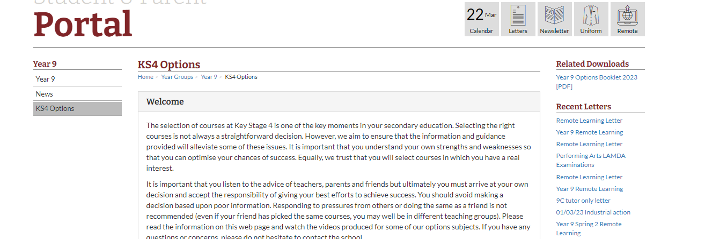
KS4 Options Portal (School Website)

Slide 12
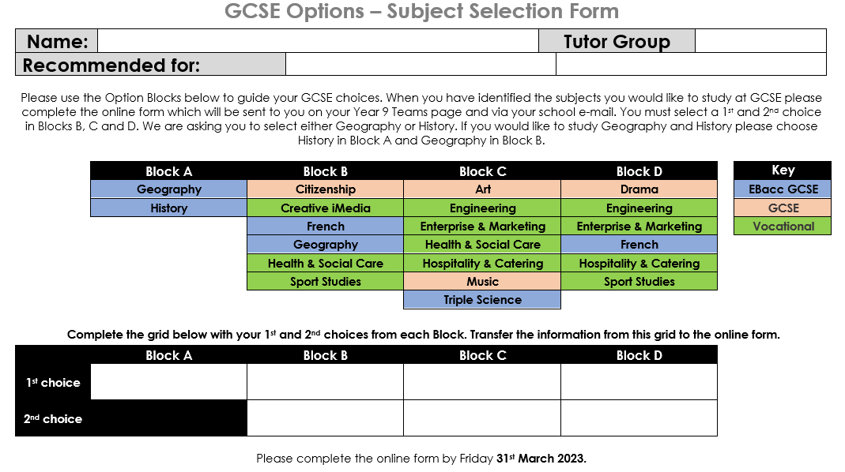
Subject Selection Form

Slide 13
Subject Selection Deadline
Complete the online form by: Friday 31st March 2023

